Slide 1
Python for Data analysts
Drug consumption
Pieter ALGERA IBO A5 Cyber sécurité

Slide 2
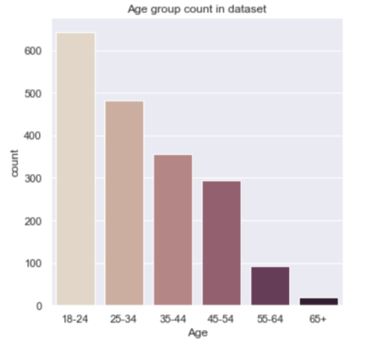
Basic Information
As would be expected, we have a lot more young people responding to the survey as we have old people as young people would have a bigger chance of seeing and responding to a query

Slide 3
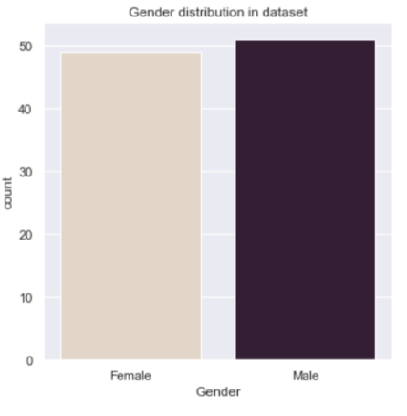
Basic Information
There are equal amounts of women and men in the dataset

Slide 4
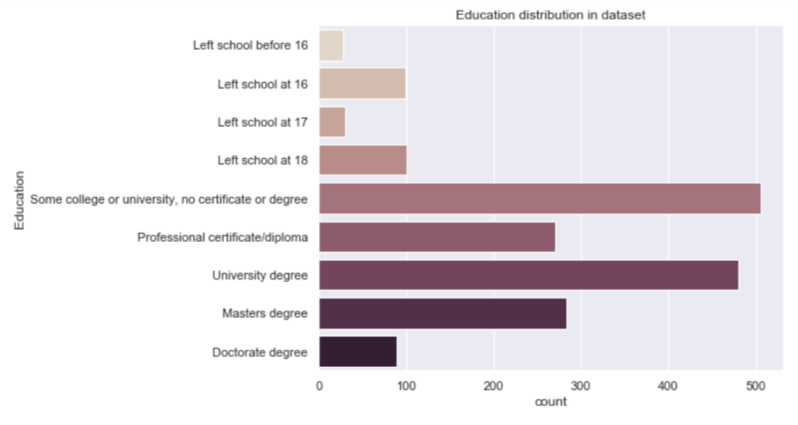
Basic Information
There is a wide variety of different education levels given in this dataset. This will mean we can get more pertinent results.

Slide 5


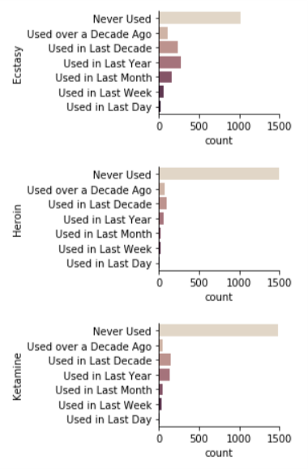
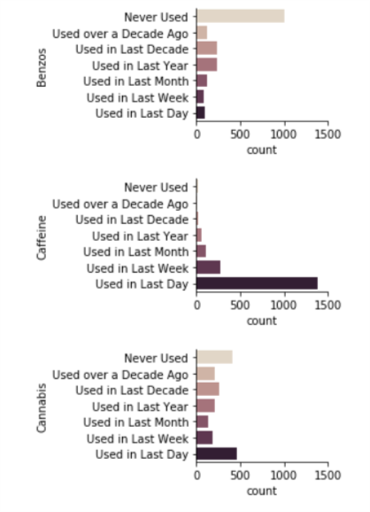
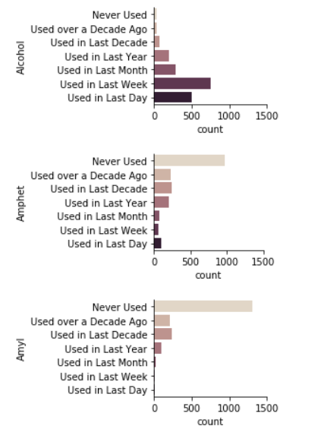



Drug usage
Here are some of the drug usage graphs. We can see that the drugs have a very different usage amount depending on the severity of the drug. For example, Caffeine is used by a lot of people while something like Heroin is used by only a few.

Slide 6
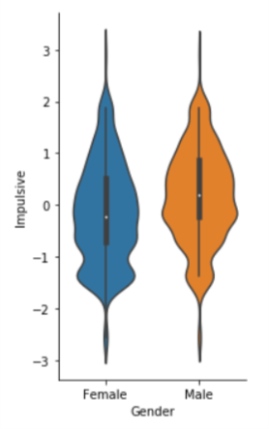
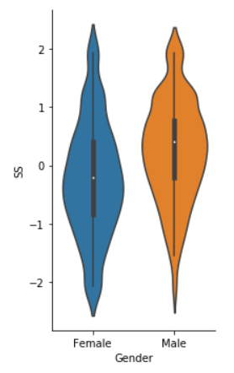
Personality score
Of the different personality traits, I want to highlight 2; The Impulsiveness and the Sensation seeking traits

Slide 7
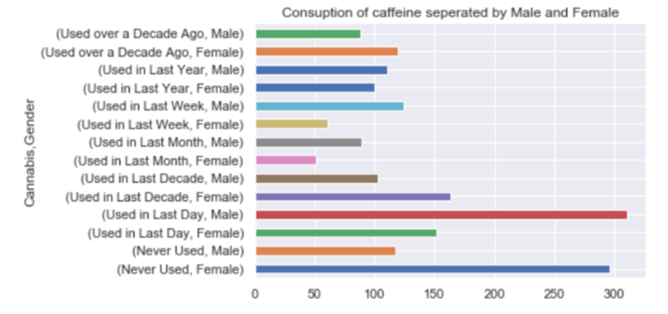
Cannabis use grouped by Gender

